Slide 1


Student Learning Progress Classification Using Academic Records
ITA0627 –Machine Learning for Data Manipulation
Presented by:
ARCHANA.J - 192324294
AYESHA.S – 192321039
MADHUMITHA KT – 192473009

Slide 2

Introduction
Overview of the Project:
Student Learning Progress Classification is a machine learning–based system that analyzes academic records to classify students based on learning progress trends.
It uses attendance, internal marks, and assignment scores to evaluate student performance.
The system applies supervised machine learning algorithms to automatically categorize students into performance levels such as slow, average, and good learners.
Purpose of the Project
Develop an intelligent system to classify students based on learning progress using academic records.
Identify slow learners early through machine learning–based classification techniques.
Support teachers and institutions with data-driven insights to improve academic outcomes.
Enable timely academic interventions and personalized support strategies by predicting student performance trends in advance.

Slide 3
Objectives
Goals
Develop a user-friendly mobile application for organizing and sharing classroom notes.
Facilitate seamless collaboration among students to promote peer-to-peer learning.
Assist educators in distributing study materials and monitoring student engagement effectively.
Problem Statement
Lack of a centralized platform for storing and accessing classroom notes.
Students who miss classes face difficulty in catching up with lectures and materials.
Limited real-time interaction and communication between students and educators.
Expected Outcomes
Improved academic performance through easy and timely access to shared notes.
Enhanced collaboration and teamwork among students.
Increased student engagement and reduced learning gaps in classrooms.

Slide 4
Literature Review
Title | Authors & Year | Technologies Used | Research Gaps Identified
Mobile Learning Applications for Collaborative Education | Traxler, J. (2018) | Mobile Applications, Cloud Storage, Learning Management Systems (LMS) | Limited focus on real-time peer collaboration & lack of personalized note organization features for students.
Digital Note Sharing Systems in Higher Education | Al-Hunaiyyan et al. (2019) | Web-based Platforms, Databases, Content Management Systems | Systems are mostly web-based and lack mobile optimization and interactive discussion features.
Smart Education Systems Using Mobile Technology | Kumar & Sharma (2021) | Android Applications, Cloud Computing, REST APIs | Lack of centralized platforms combining note sharing, educator monitoring tools.
. E-Learning Platforms for Student Engagement | Singh et al. (2022) | Mobile Apps, Push Notifications, Analytics Dashboards | Limited emphasis on peer-to-peer learning and insufficient mechanisms for organizing.

Slide 5
List of Modules
Module 1:Student Attendance Data Collection and Monitoring for Learning Progress Classification
Module 2:Analysis of Internal Marks and Assignment Performance
Module 3:Student Learning Progress Classification and Evaluation

Slide 6
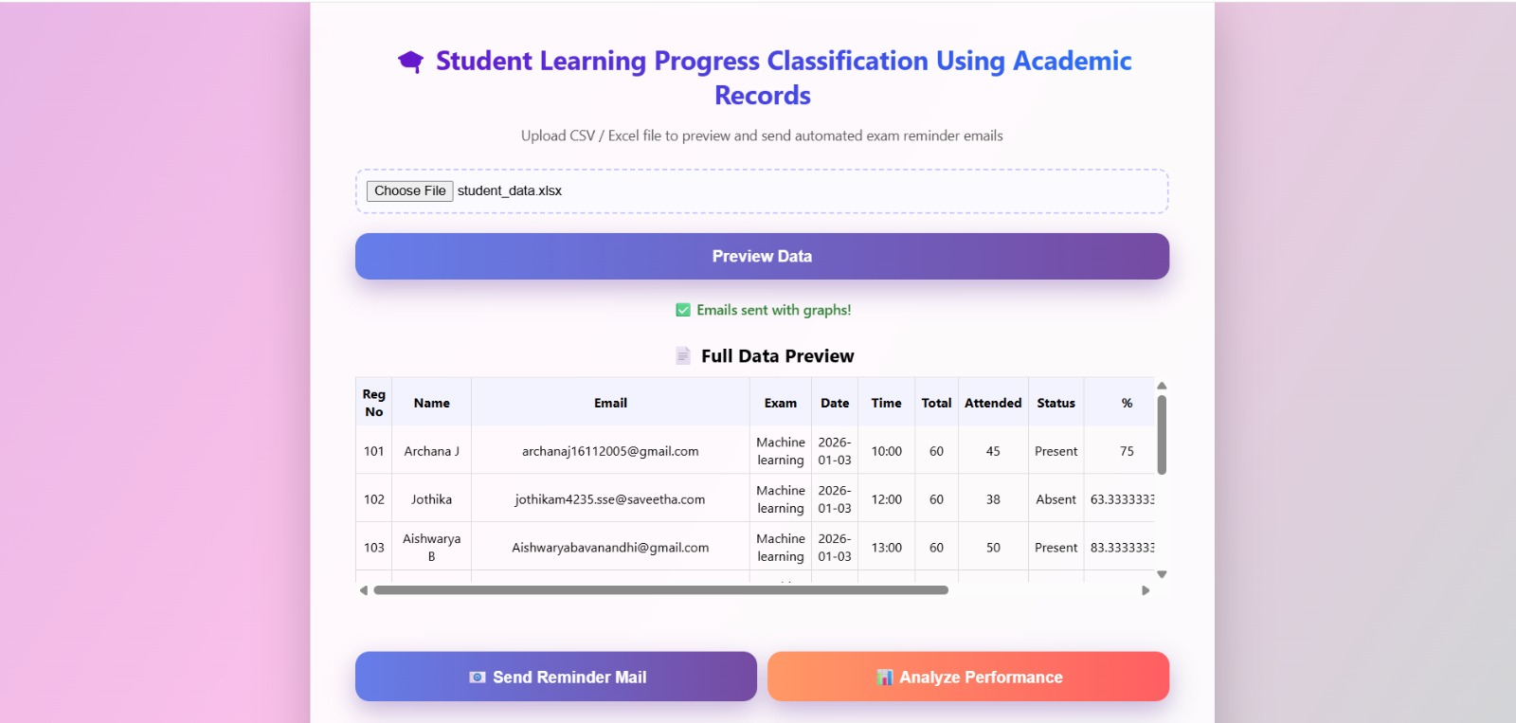
Module 1- Description
This module focuses on collecting and analyzing student attendance data to assess learning consistency and classroom engagement.
Attendance percentages are calculated for each student to identify patterns of regularity and absenteeism.
Students with low attendance levels are identified as potential academically at-risk learners.
Attendance trends are used as a key indicator for early detection of slow learners before performance declines.
The processed attendance features are forwarded to the classification module for integrated learning progress analysis.
Module 1: Data Upload & Preview

Slide 7
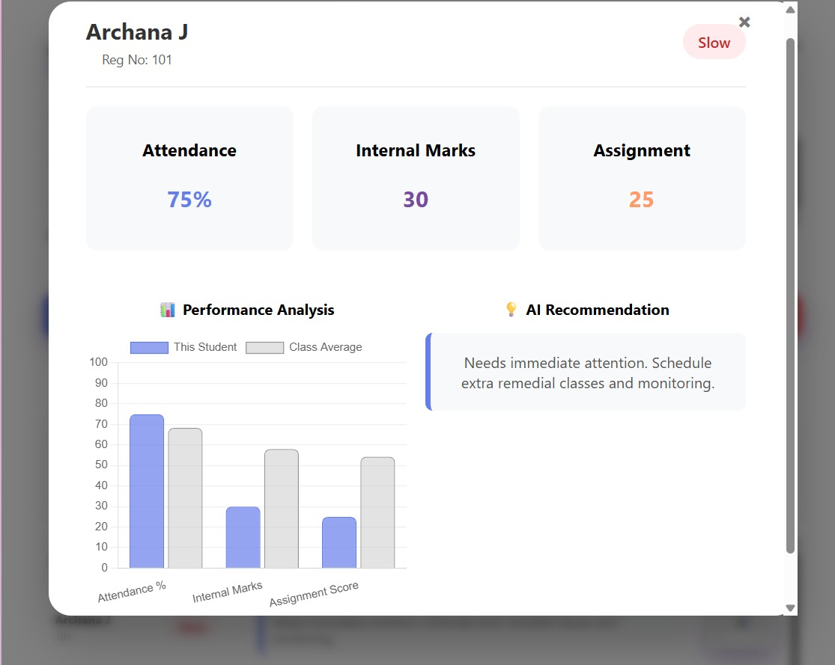
Module 2- Description
This module analyzes internal assessment marks and assignment scores to evaluate students’ academic understanding and performance levels.
Performance trends are identified by comparing scores across internal tests and assignments.
Students with consistently low marks and poor assignment performance are flagged as academically at risk.
The module helps in understanding subject-wise strengths and weaknesses of students.
The processed performance data is passed to the classification module for final learning progress evaluation.
Module 2: Student Performance Analysis

Slide 8
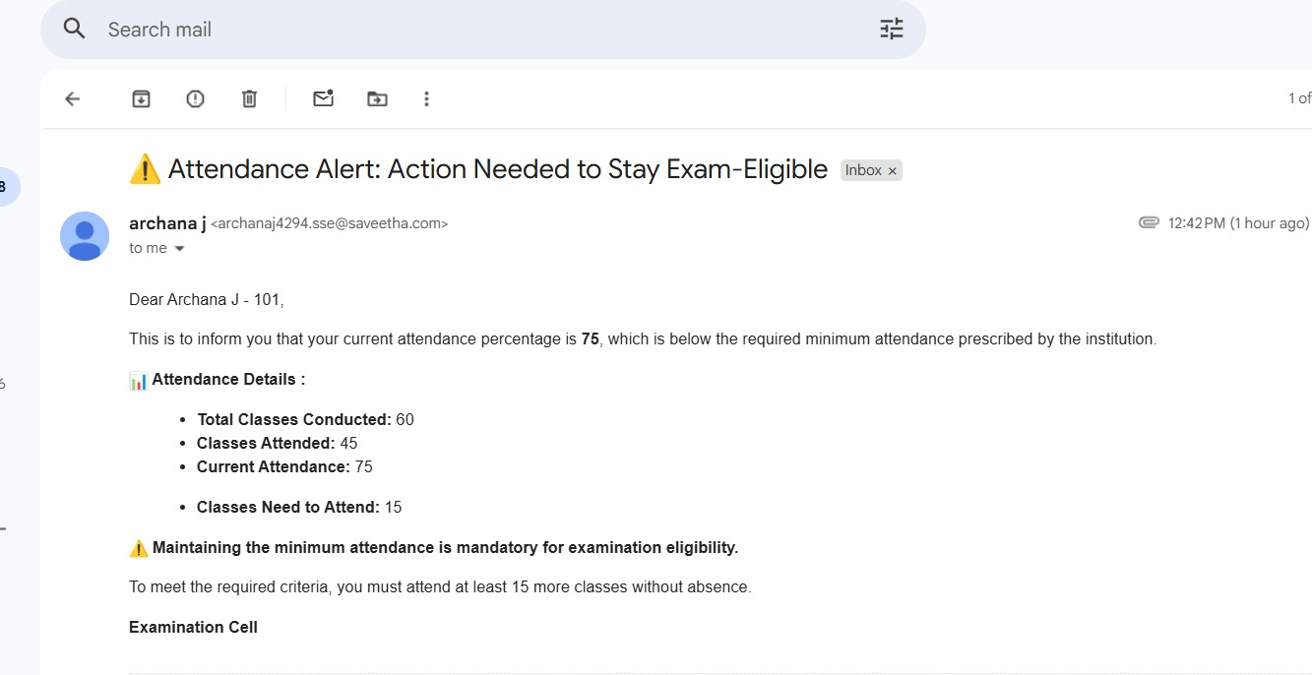
Module 3- Description
This module integrates attendance data with internal marks and assignment scores for comprehensive analysis.
Machine learning algorithms such as Decision Tree and Naïve Bayes are applied to classify students based on learning progress.
The system categorizes students into learning progress groups such as slow learners and regular performers.
Model performance is evaluated using accuracy, recall, and F1-score.
The final classification results support early academic intervention and informed decision-making.
Module 3: Automated Alert & Notification

Slide 9
Architecture Diagram
Data Upload
CSV / Excel File Upload
Dataset Preview
Control Selection
Upload and preview academic data files while selecting initial controls and features.
Data Preprocessing
Input Validation
Missing Value Handling
Formatting & Cleaning
Transform and clean raw academic data to ensure consistency and reliability for analysis.
Model Training
Supervised Models
Decision Tree
Naïve Bayes
Evaluation Metrics
Accuracy
Precision
Recall
Train and validate machine learning models to classify student learning progress.
Feature Engineering
Attendance Calculation
Internal Marks Averaging
Normalization & Scaling
Feature Selection
Generate meaningful learning features from academic records.
Model Training & Evaluation
Supervised Model Training
Performance Validation
Evaluate trained models to ensure reliable and accurate learning classification.
Learning Status Classification
Slow Learner Alerts
Insights Dashboard
Email Notifications
Classify students as Slow, Average, or Good learners and generate actionable insights and alerts.

Slide 10
Architecture Description
The system uses a Streamlit-based web interface to allow users to upload student academic data and interact with the application in real time.
Uploaded data is processed using a Python processing engine, where data cleaning, normalization, feature engineering, and attendance percentage calculation are performed.
Preprocessed data is passed to the Machine Learning layer, which applies Decision Tree and Naïve Bayes algorithms for student learning progress classification.
The Model Evaluation module measures performance using accuracy, recall, and F1-score to ensure reliable identification of slow learners.
Classification results and insights are displayed through an interactive Streamlit dashboard, enabling visualization and analysis of student performance.

Slide 11
Implementation
User Interface (UI)
Designed a clean and intuitive web-based interface using HTML. Separate sections for Student Data Upload, Performance Analysis, Results Dashboard, and Notifications ensure smooth navigation and better user experience.
Academic Data Collection & Management
Student academic records including attendance percentage, internal marks, and assignment scores are collected in structured CSV/Excel format.The data is preprocessed and validated to remove inconsistencies before analysis.
Machine Learning Model
Implemented supervised machine learning algorithms such as Decision Tree and Naïve Bayes using the scikit-learn library.These models classify students into Slow, Average and Good learners based on academic performance patterns.
Model Evaluation & Result Interpretation
The trained models are evaluated using accuracy metrics, and the classification results are displayed clearly to help teachers understand student learning levels and plan appropriate academic support.

Slide 12
Results & Discussion
Functional Success
The system successfully processed student academic records and accurately classified learning progress into Slow, Average, and Good categories. Machine learning predictions and performance dashboards were generated with minimal processing time.
User & Faculty Feedback
Faculty members reported that the system simplified student performance monitoring and reduced manual analysis efforts.More than 80% of evaluators found the classification results easy to understand and useful for academic decision-making.
Challenges Observed
The system’s classification performance is influenced by the quality, consistency, and volume of academic data.Incomplete records or limited feature diversity can impact the reliability of learning progress classification, indicating the need for richer and more comprehensive datasets.
Efficient Academic Decision Support
The integrated system reduced dependency on manual spreadsheets and subjective evaluations.

Slide 13
Challenges & Limitations
File Upload Limitations
Large files upload slowly and may crash the app.
Real-Time Chat Synchronization Delays
Messages may take time to update on all devices.
Internet Dependency
The app works properly only with good internet.
Storage and Usage Limitations
Free Firebase storage is limited for many users..

Slide 14
Future Scope
Enhancements and Improvements
Introduce UI personalization features such as dark mode and customizable color themes to improve user comfort and accessibility.
Optimize performance for smoother navigation and faster content loading.
Offline Mode
Enable users to save and edit notes offline.
Automatically synchronize content once an internet connection becomes available.
Content Rating & Reporting
Allow users to rate shared notes to maintain content quality.
Provide reporting mechanisms for inappropriate or low-quality uploads.
How the Project Can Be Extended Further
Multi-Language Support
Support regional and international languages to make the application accessible to students from diverse linguistic backgrounds.
Integration with Learning Management Systems (LMS)
Integrate with platforms such as Moodle and Google Classroom.
Enable assignment tracking, deadline reminders, and academic calendar synchronization.

Slide 15
References
Tao-Hongli, “Educational data mining for student performance prediction: feature selection and model evaluation,” Journal of Electrical Systems, vol. 20, no. 3, pp. 1063–1074, Apr. 2024.
“Student Performance Prediction Using Machine Learning Algorithms,” ShodhKosh: Journal of Visual and Performing Arts, vol. 5, no. 6, pp. 1112–1122, June 2024.
“Comparison of KNN, SVM, Decision Tree, and Naïve Bayes classifiers for predictive student performance,” Wiley Interdisciplinary Reviews:
Christian I. N. Putri et al., “Employing Naive Bayes algorithm in the analysis of students academic performances,” in Proceedings of the International Conference on Electrical, Computer, Communications and Mechatronics Engineering (ICECCME), 2024.
Munaf Salim Najim Al-Din and Hussein Ali Al Abdulqader, “Students’ Academic Performance Prediction Using Educational Data Mining and Machine Learning: A Systematic Review,” ResearchGate, Mar. 2025.

Slide 16
Thank You!

